Slide 1

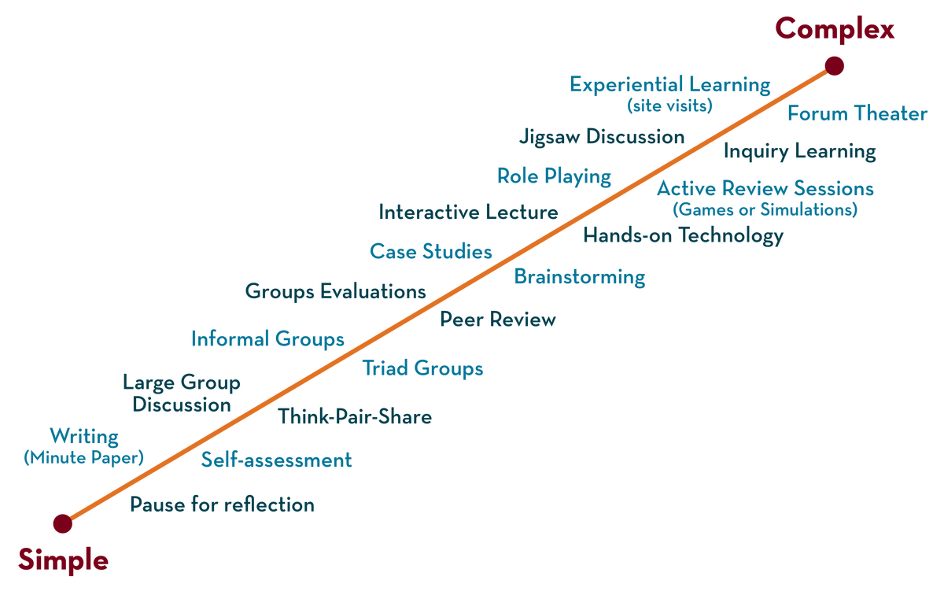
Department of CSE
FRONT END WEB DEVELOPMENT (EPAM)
21CS3017AA/21CS3017PA
Topic:
Git Advanced commands
Session - 2

Slide 2



AIM OF THE SESSION
To familiarize students with the moderate command of GIT CLI
INSTRUCTIONAL OBJECTIVES
This Session is designed to:
Demonstrate the Advance commands in GIT CLI
LEARNING OUTCOMES
At the end of this session, you should be able to:
Apply the commands and understand the process of working.

Slide 3
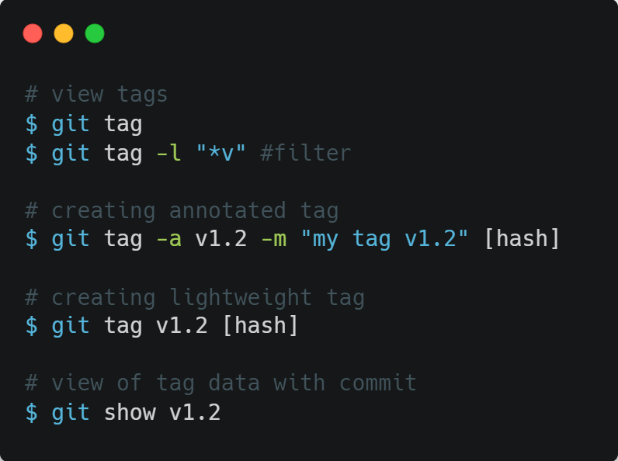
GIT TAG
SESSION INTRODUCTION
Git allows to tag specific moments in commits history as important. As a rule, tags are used for identifying version issue moment.
Tags can be of 2 types:
Annotated – user information, date etc
are stored
Lightweight – only tag name is stored

Slide 4
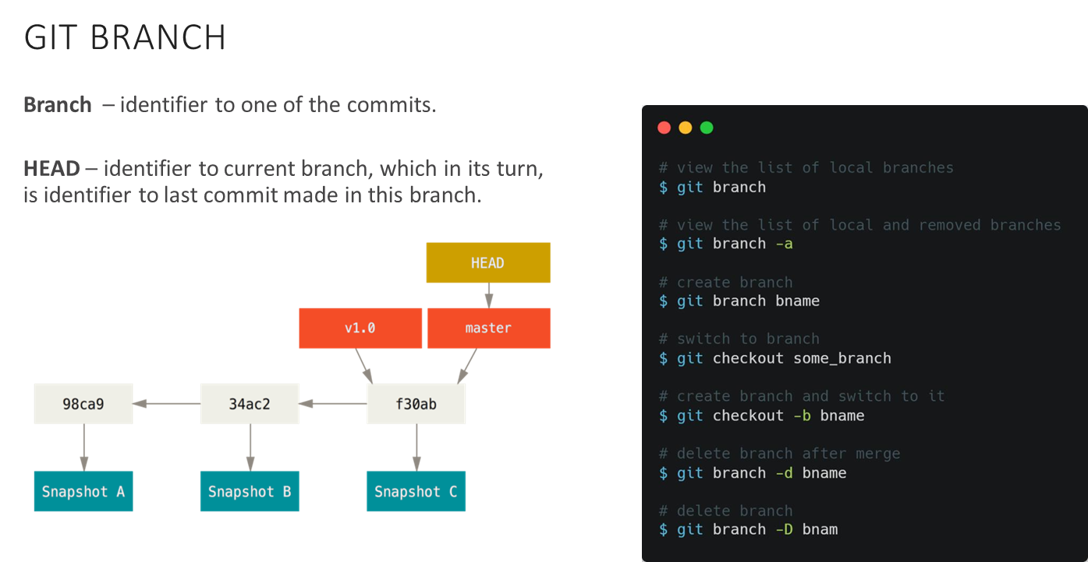
SESSION DESCRIPTION (Cont..)

Slide 5
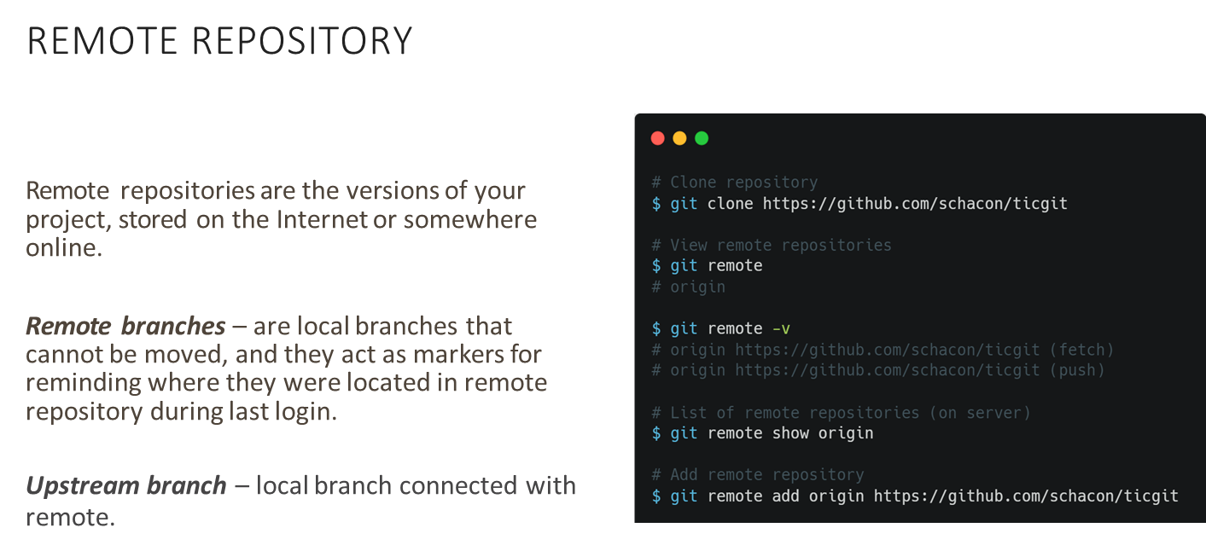
SESSION DESCRIPTION (Cont..)

Slide 6
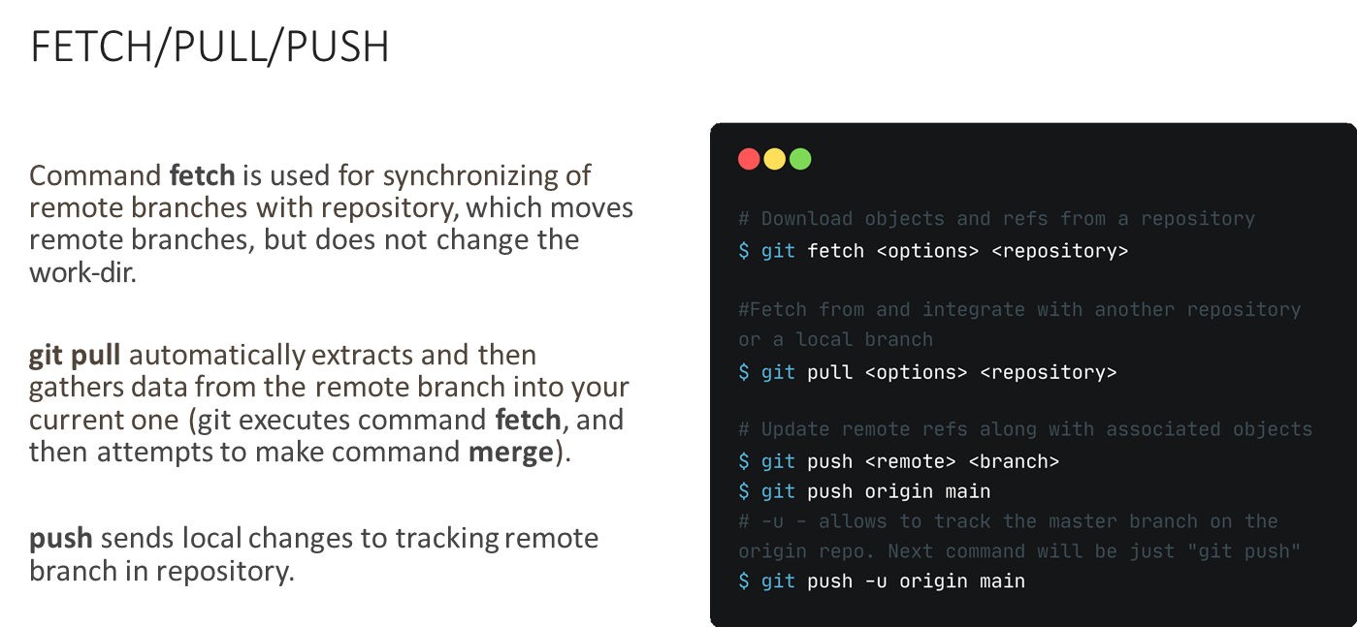
SESSION DESCRIPTION (Cont..)

Slide 7
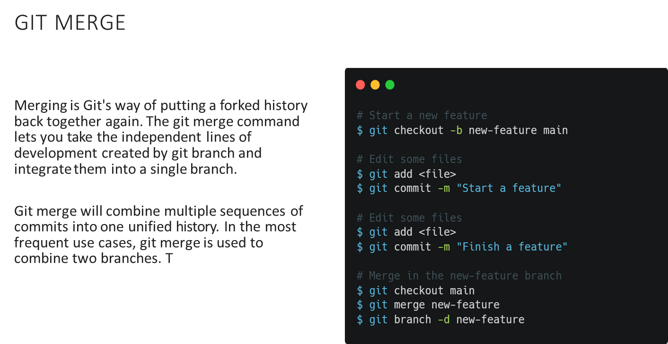
SESSION DESCRIPTION (Cont..)

Slide 8
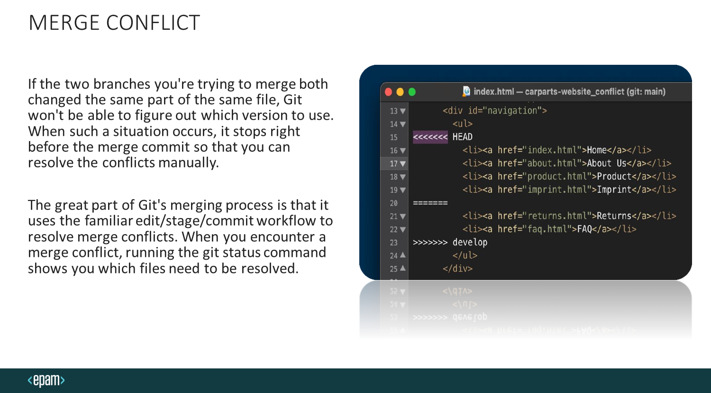
SESSION DESCRIPTION (Cont..)

Slide 9
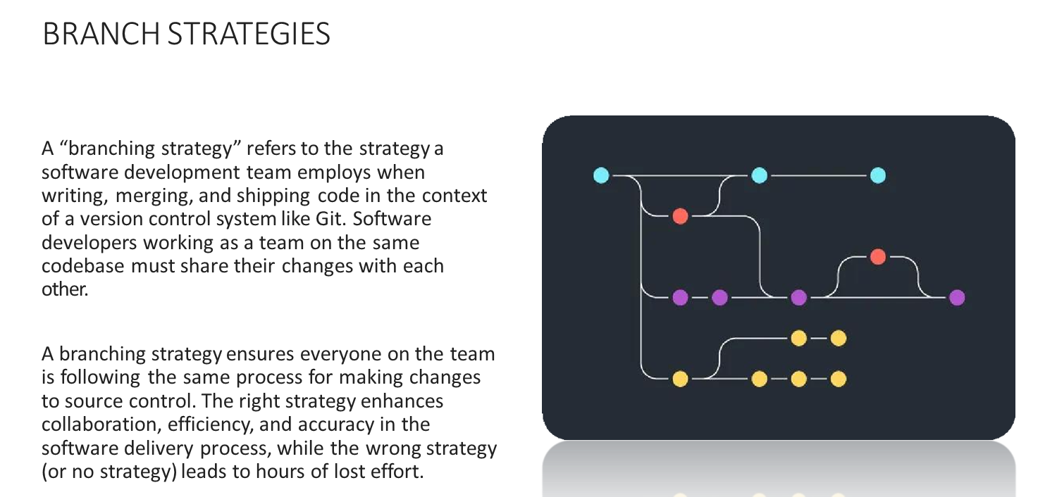
SESSION DESCRIPTION (Cont..)

Slide 10
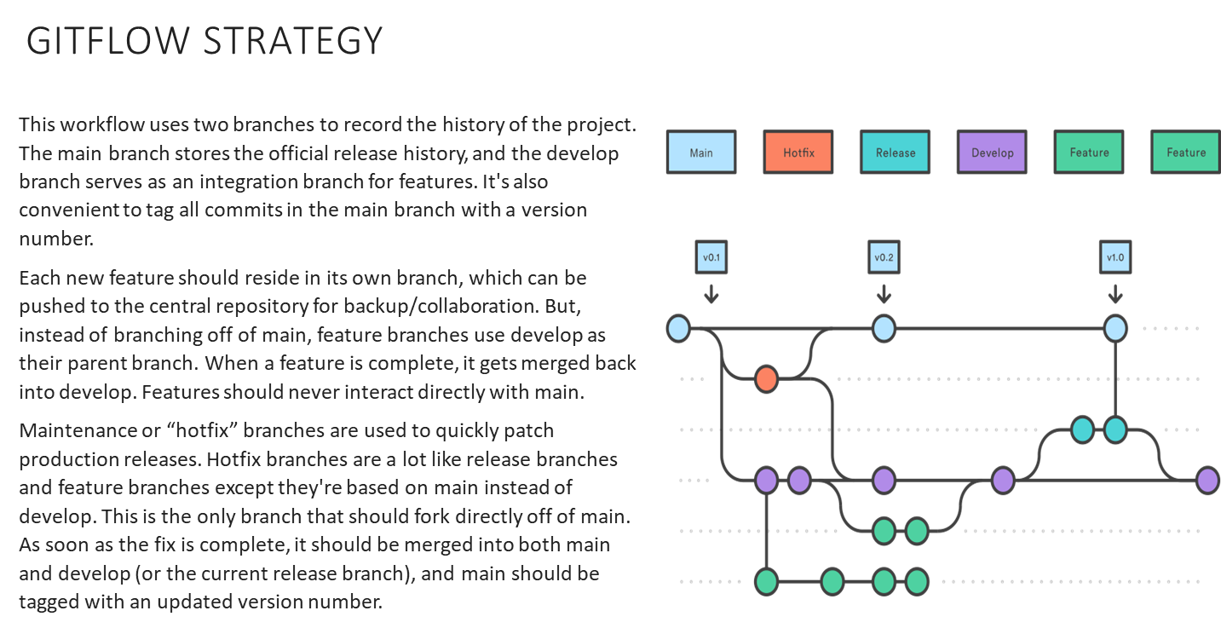
SESSION DESCRIPTION (Cont..)

Slide 11
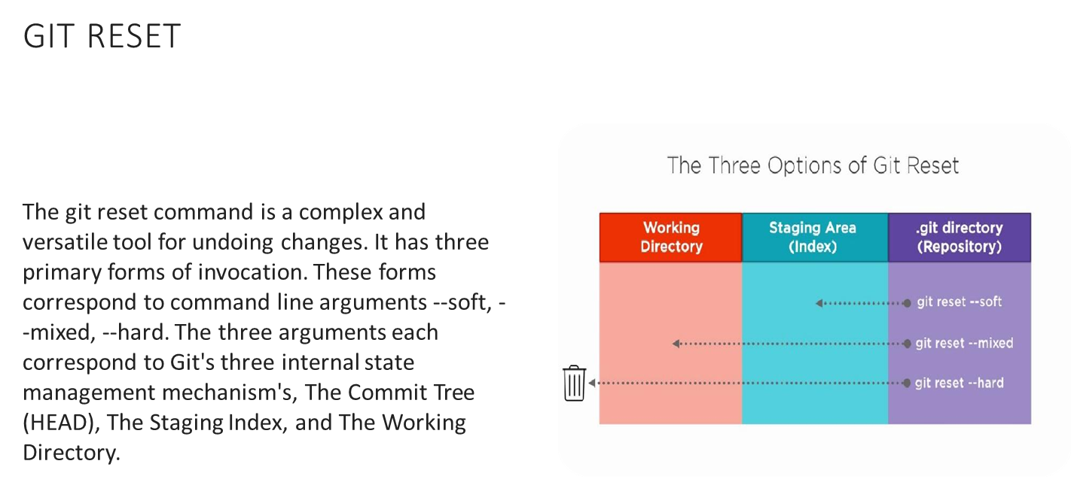
SESSION DESCRIPTION (Cont..)

Slide 12
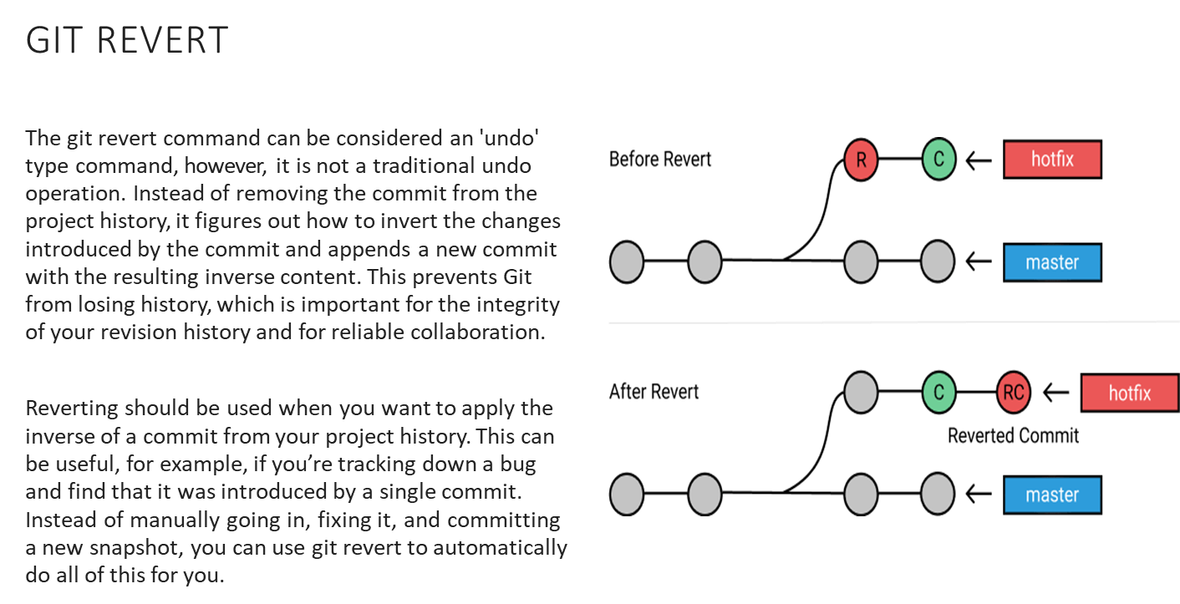
SESSION DESCRIPTION (Cont..)

Slide 13
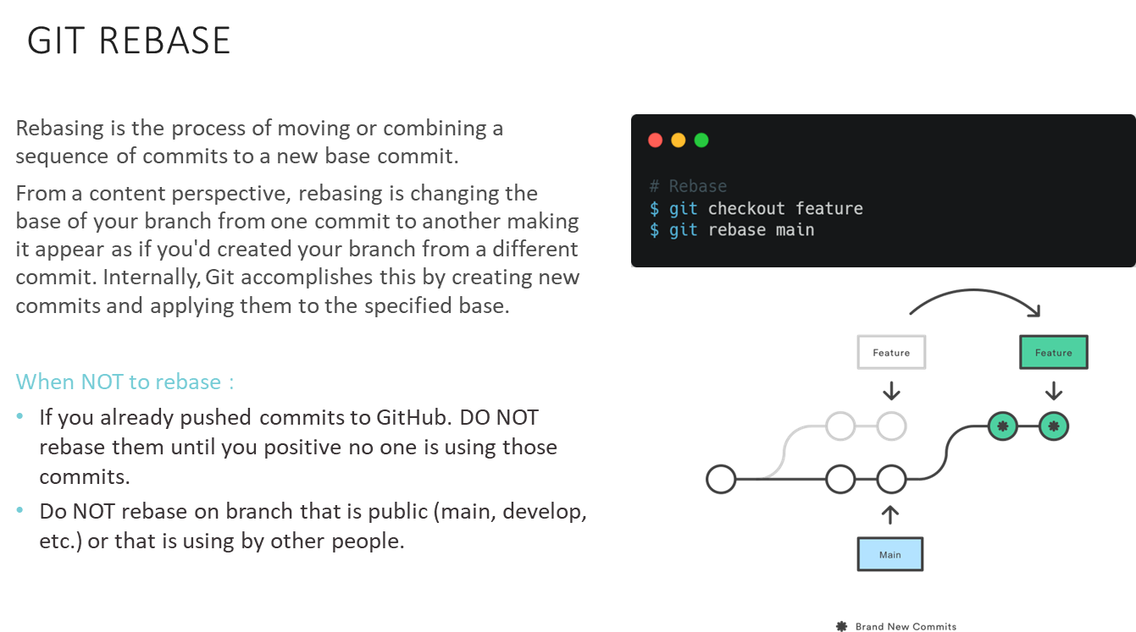
SESSION DESCRIPTION (Cont..)

Slide 14
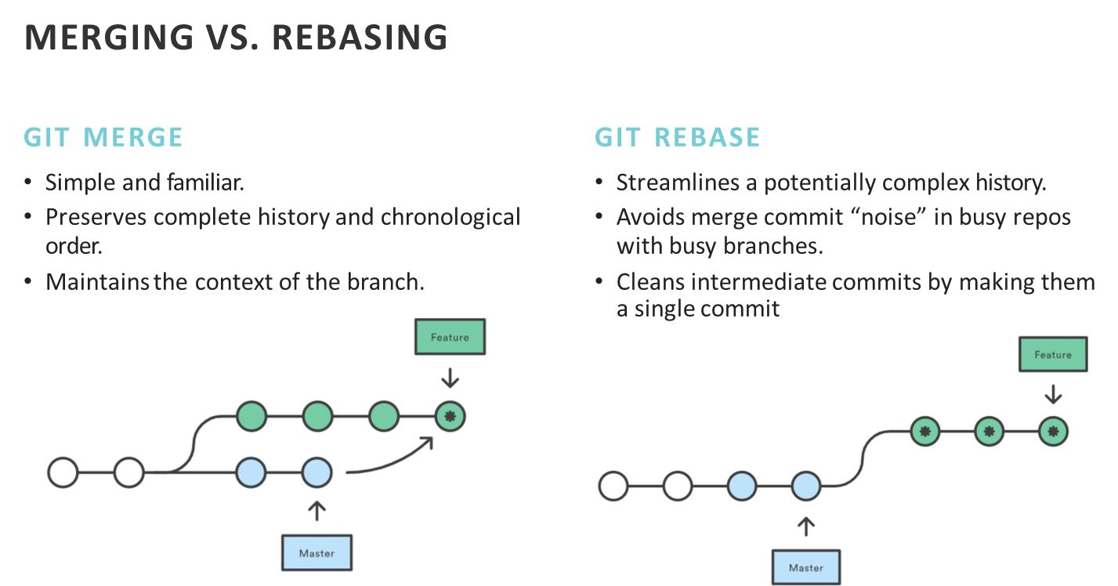
SESSION DESCRIPTION (Cont..)

Slide 15

SESSION DESCRIPTION (Cont..)
RESOURCES
https://git-scm.com/book/en/v2/Getting-Started- About-Version-Control
https://about.gitlab.com/topics/version-control/
https://www.atlassian.com/git/tutorials/learn-git- with-bitbucket-cloud
https://serengetitech.com/tech/introduction-t and-types-of-version-control-systems/
https://learngitbranching.js.org/

Slide 16
ACTIVITIES/ CASE STUDIES/ IMPORTANT FACTS RELATED TO THE SESSION
Installation of GIT.
Create the personal repository for storing all the works.

Slide 17
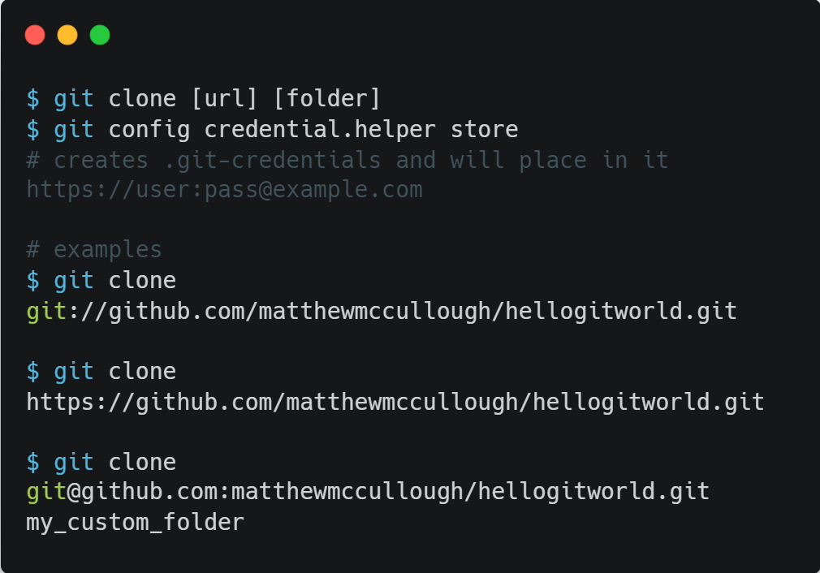
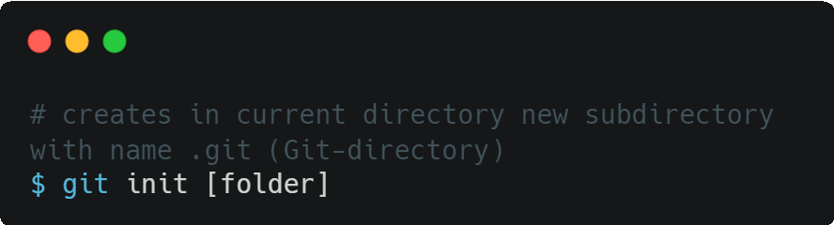
EXAMPLES

Slide 18
SUMMARY
Apply the commands for initialization of Git Repository
Apply the commands for Clone the external Git Repository
You should have a basic understanding of what Git is and how it’s different from any centralized version control systems you may have been using previously.
You should also now have a working version of Git on your system that’s set up with your personal identity. It’s now time to learn some Git basics.

Slide 19
THANK YOU
Team – Course Name

